Slide 1
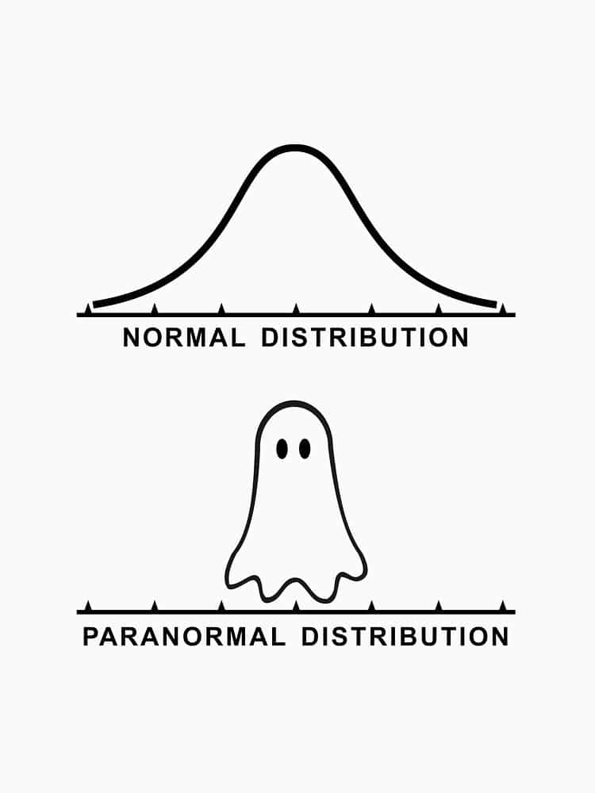
Variables, Distributions, Sampling
ENTMLGY 6702 Entomological Techniques and Data Analysis

Slide 2
Learning objectives
Differentiate between categorical and continuous variables
Compare common probability distributions – and their parameters - used to model biological data
Describe basic parameters and equations for summarizing data

Slide 3
Variables
Variables are properties with respect to which individuals in a sample differ in some ascertainable way. If properties do not differ (= no variability), they cannot be of statistical interest.
Variables come in two general forms:
Continuous: numeric, can range from -∞ to ∞; “measured”
Examples: Time (seconds, minutes), height (m), weight (g), elevation, temperature (°C), precipitation (mm)
Categorical: also called discrete or discontinuous; has two or more categories; “counted”

Slide 4
Categorical variables
Nominal: categories without a number assigned to them.
Examples: biological sex; species; survival; survey data (yes/no)
Count data: integers, rates (= integers per unit of time or space)
Examples: insects or plants per m²
Ordinal: categories in ordered form
Examples: survey data (disagree, neutral, agree); crown class (co-dominant, dominant intermediate, suppressed)

Slide 5
For a given variable, what’s the expected distribution?
Variable
Continuous
Normal (Gaussian)
Categorical
Two categories
Binomial
Integers, rates
Poisson
Activity: Describe one response variable you are measuring as part of your thesis, including (i) whether it’s continuous vs. categorical and (ii) its expected distribution.

Slide 6
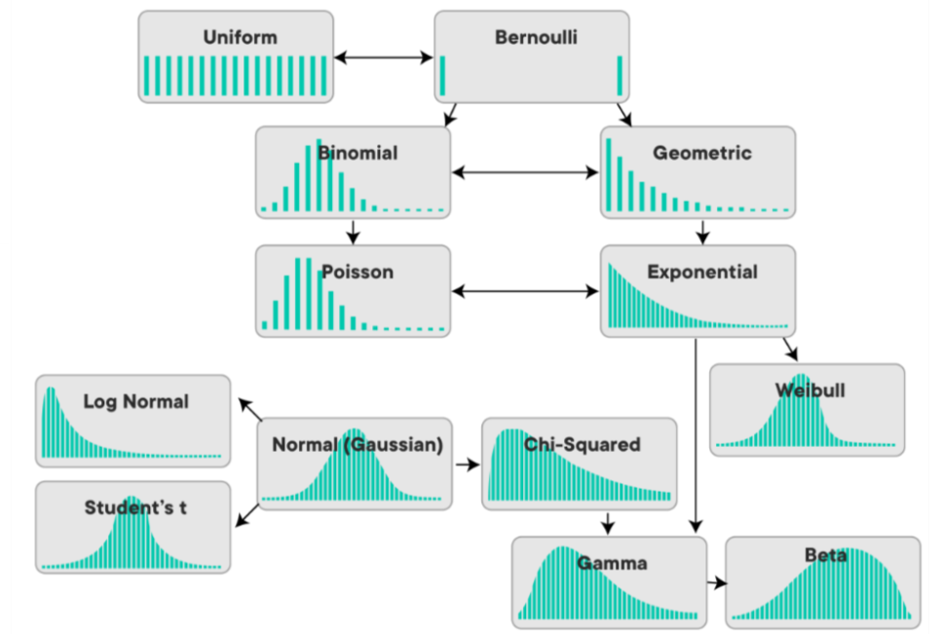
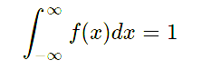
Probability distributions…there’s a lot of ‘em

Slide 7
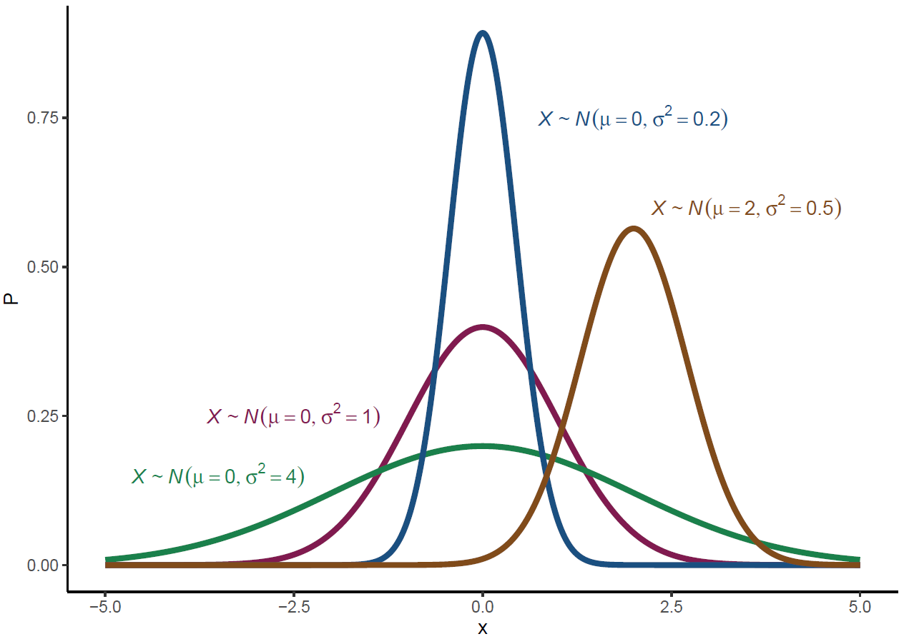
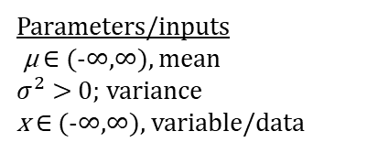

Normal (Gaussian) distribution
$$f\left(x\right)=\frac{1}{σ\sqrt{2π}}e^{−\frac{1}{2}{\left(\frac{x−μ}{σ}\right)}^{2}}$$
Parameters/inputs
$\text{µ}$ ∈ (-∞,∞), mean
$σ^{2}$> 0; variance
x ∈ (-∞,∞), variable/data

Slide 8
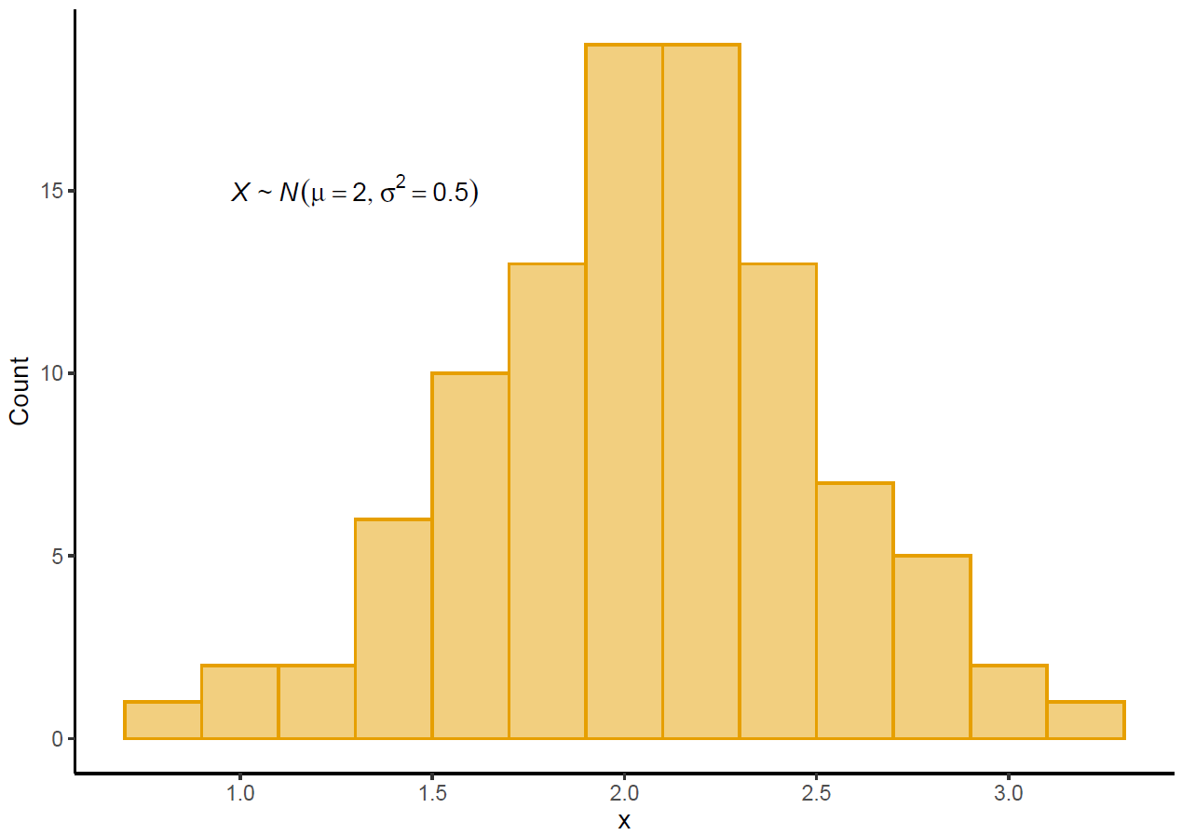
Normal (Gaussian): sample

Slide 9
Quick refresher on notation
Y = (4,8,1,1,30,5)
Y₁ =4
Y₅ =30

Slide 10
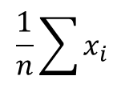
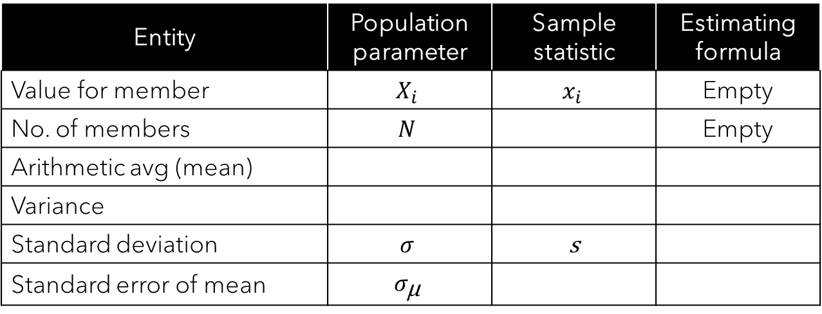
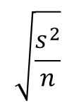

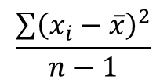
Mean, variance, SE
Activity: I have provided (i) some of the answers and (ii) formulas for the last column (in random order). Please try to fill out the rest from memory.
Entity | Population parameter | Sample statistic | Estimating formula
Value for member | $$X_{i}$$ | $$x_{i}$$ | Empty
No. of members | $$N$$ |  | Empty
Arithmetic avg (mean)
Variance
Standard deviation | $$σ$$ | s
Standard error of mean | $$σ_{\text{µ}}$$
$$\sqrt{\frac{s^{2}}{n}}$$
$$\frac{\sum{{\left(x_{i}−\overline{x}\right)}^{2}}}{n−1}$$
$$\sqrt{s^{2}}$$
$$\frac{1}{n}\sum{x_{i}}$$

Slide 11
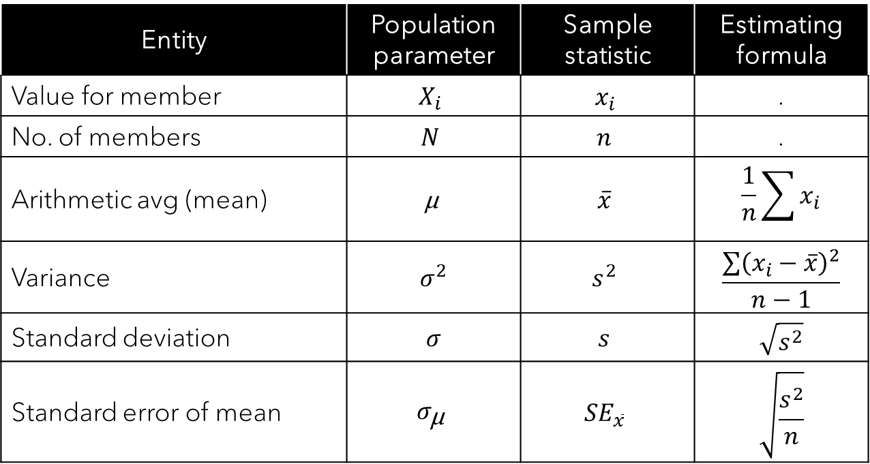
Mean, variance, SE
Entity | Population parameter | Sample statistic | Estimating formula
Value for member | $$X_{i}$$ | $$x_{i}$$ | .
No. of members | $$N$$ | $$n$$ | .
Arithmetic avg (mean) | $$\text{µ}$$ | $$\overline{x}$$ | $$\frac{1}{n}\sum{x_{i}}$$
Variance | $$σ^{2}$$ | $$s^{2}$$ | $$\frac{\sum{{\left(x_{i}−\overline{x}\right)}^{2}}}{n−1}$$
Standard deviation | $$σ$$ | $$s$$ | $$\sqrt{s^{2}}$$
Standard error of mean | $$σ_{\text{µ}}$$ | $${SE}_{\overline{x}}$$ | $$\sqrt{\frac{s^{2}}{n}}$$
$$\sqrt{\frac{s^{2}}{n}}$$
$$\frac{\sum{{\left(x_{i}−\overline{x}\right)}^{2}}}{n−1}$$
$$\sqrt{s^{2}}$$
$$\frac{1}{n}\sum{x_{i}}$$

Slide 12
Mean, variance, SE
Entity | Population parameter | Sample statistic | Estimating formula
Value for member | $$X_{i}$$ | $$x_{i}$$ | .
No. of members | $$N$$ | $$n$$ | .
Arithmetic avg (mean) | $$\text{µ}$$ | $$\overline{x}$$ | $$\frac{1}{n}\sum{x_{i}}$$
Variance | $$σ^{2}$$ | $$s^{2}$$ | $$\frac{\sum{{\left(x_{i}−\overline{x}\right)}^{2}}}{n−1}$$
Standard deviation | $$σ$$ | $$s$$ | $$\sqrt{s^{2}}$$
Standard error of mean | $$σ_{\text{µ}}$$ | $${SE}_{\overline{x}}$$ | $$\sqrt{\frac{s^{2}}{n}}$$

Slide 13
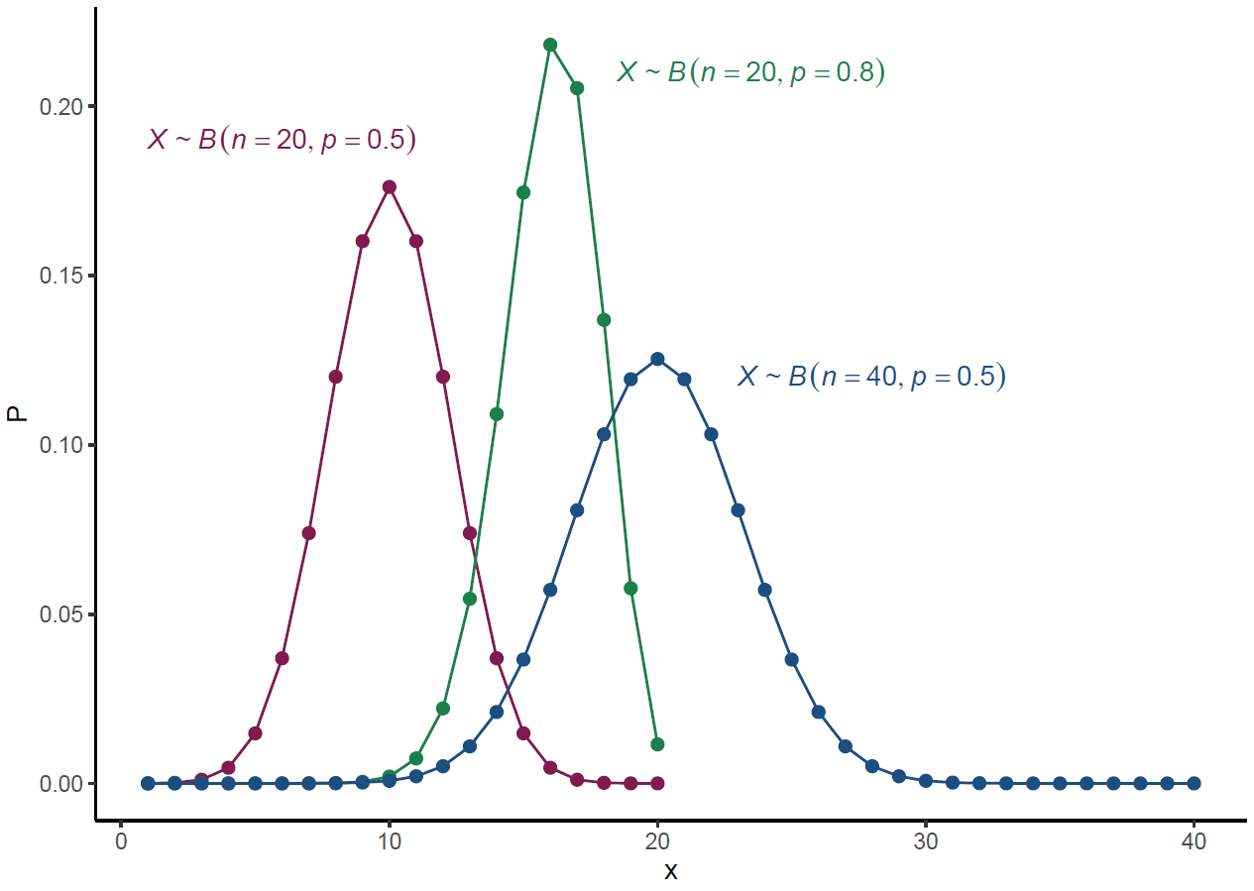


Binomial distribution
Parameters/inputs
n ∈ (0, ∞), number of trials
p ∈ (0, 1), probability of success per trial
q =p – 1; probability of failure per trial
x ∈ (0, n), number of times a given outcome occurred across n trials
$$f(x,n,p)=\left({n \atop x}\right)p^{x}{(1−p)}^{n−x}$$
$$\left({n \atop x}\right)=\frac{n!}{x!\left(n−x\right)!}$$
Note: A Bernoulli distribution is a special case of a Binomial distribution in which n, the number of trials, equals 1. For example, flipping a coin once (= Bernoulli) vs twenty times (= Binomial)

Slide 14
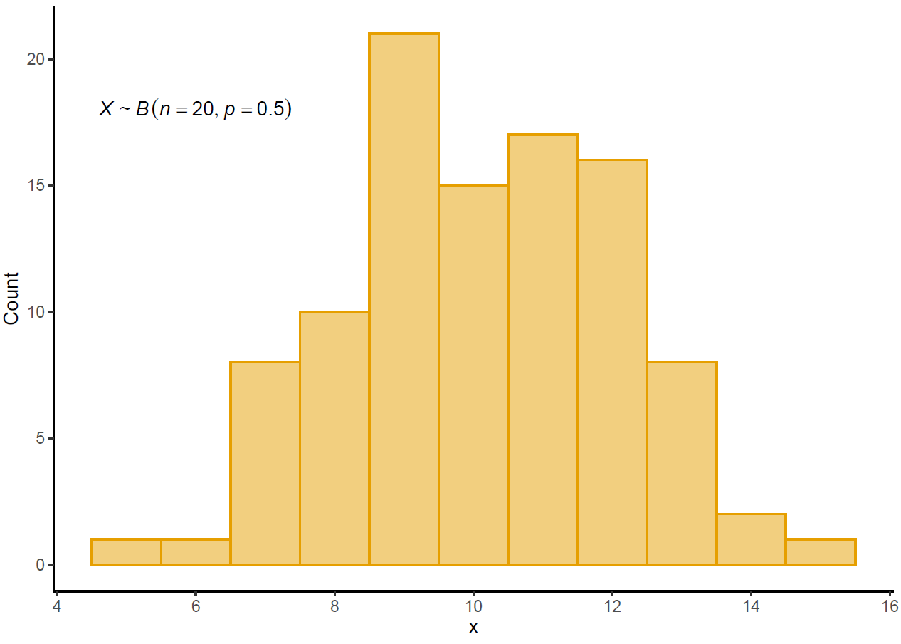
Binomial

Slide 15
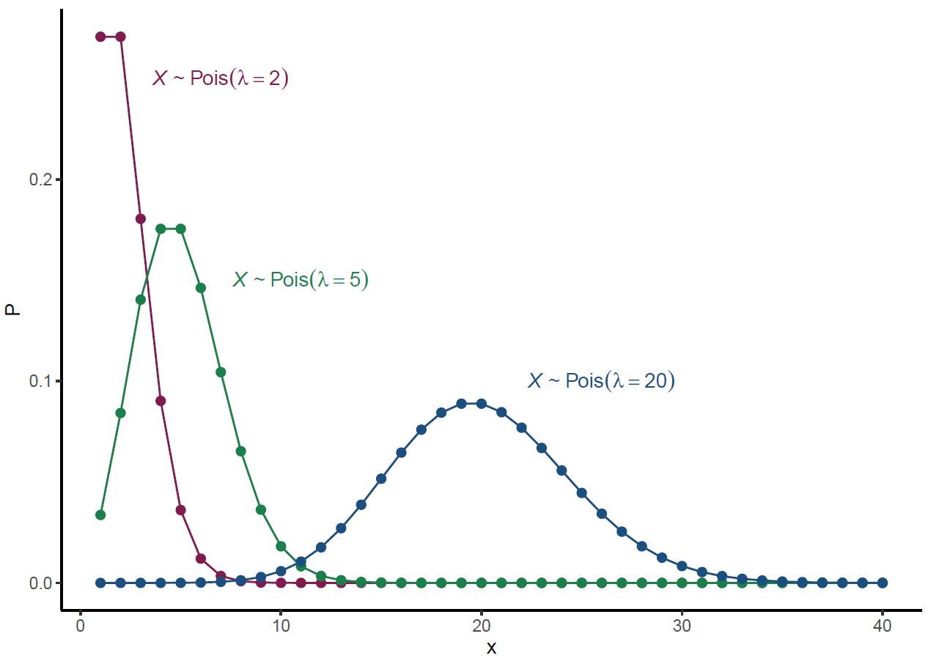

Poisson distribution
$$f(x,\text{λ})=\frac{{\text{λ}}^{x}e^{−\text{λ}}}{x!}$$
Parameters/inputs
λ ∈ (0, ∞), mean AND variance
x ∈ (0, ∞), variable/data (counts)

Slide 16
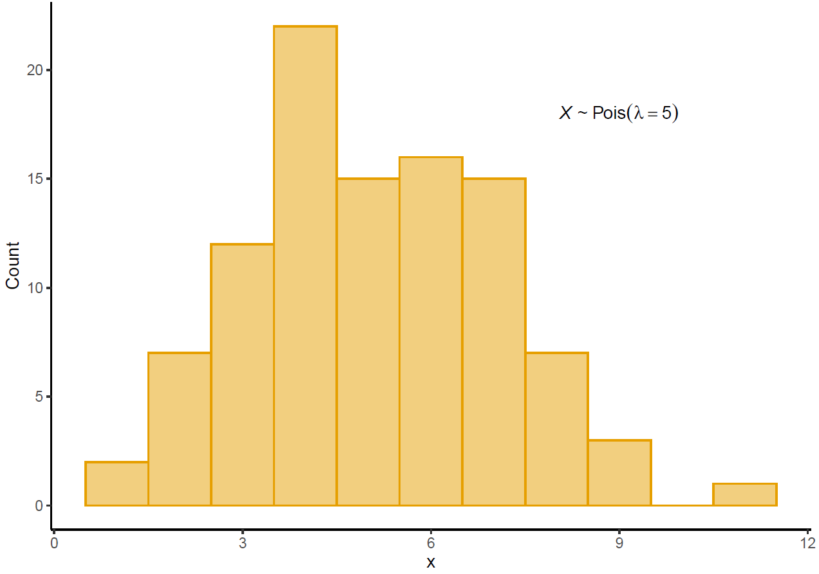
Poisson: sample

Slide 17

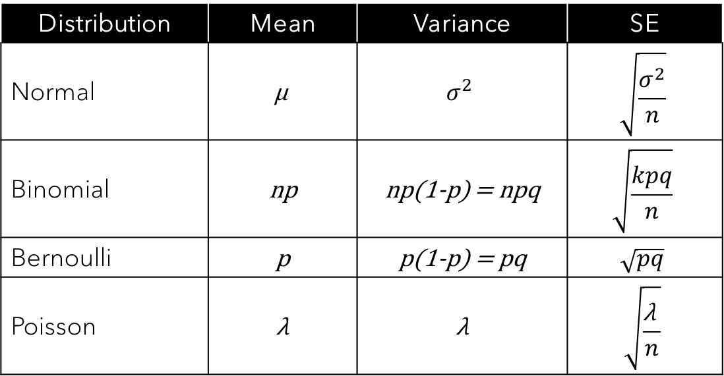
Summary of distributions and their parameters
Distribution | Mean | Variance | SE
Normal | $$\text{µ}$$ | $$σ^{2}$$ | $$\sqrt{\frac{σ^{2}}{n}}$$
Binomial | np | np(1-p) = npq | $$\sqrt{\frac{kpq}{n}}$$
Bernoulli | p | p(1-p) = pq | $$\sqrt{pq}$$
Poisson | λ | λ | $$\sqrt{\frac{\text{λ} }{n}}$$
$$k=number of trials$$
$$n=overall sample size$$

Slide 18
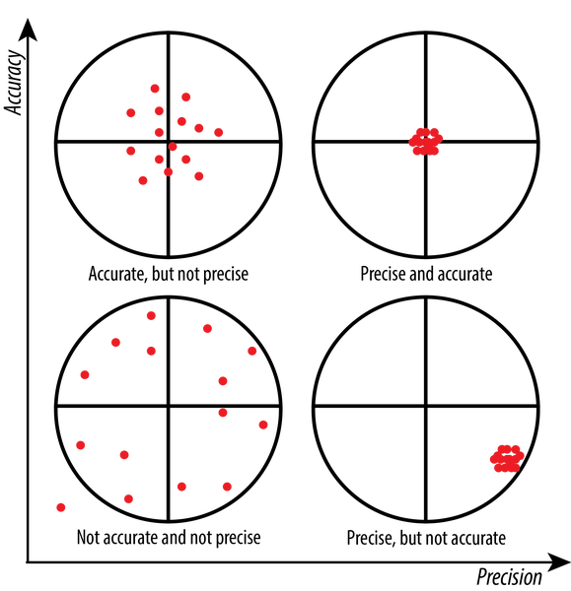
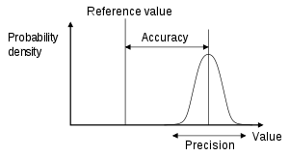
Precision and accuracy
https://wp.stolaf.edu/it/gis-precision-accuracy/

Slide 19


Independence
Each color represents a site. Each site has one insect sampled per tree.

Slide 20
Independence…?
Each color represents a site. Each site has one insect sampled per tree, BUT multiple trees are sampled per site.
Notes:
Need to account for the fact that samples are clustered or grouped by site

Slide 21
Repeated measures
Each color represents a site. Each site has one sample per tree per day, BUT trees are sampled on multiple days.
Notes:
You would want to statistically account for the effect of tree (i.e., samples are clustered within a tree over time) and time (i.e., samples are clustered by sample day). There is no longer any clustering by site.

Slide 22
Independence…?
Each color represents a site. Each site has one sample per tree per day, BUT NEW trees are sampled on each visit.
Notes:
One might want to account for the effect of time (i.e., your sampling is grouped by sample day) and site (i.e., trees are still grouped by site)

Slide 23
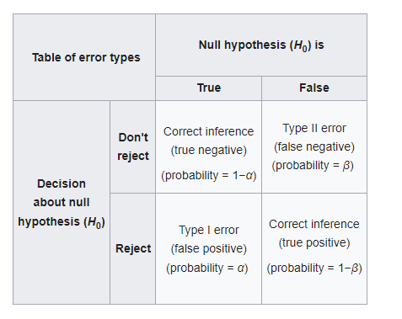
Four options in hypothesis testing
https://en.wikipedia.org/wiki/Type_I_and_type_II_errors

Slide 24
Type I error
Type I error (α): rejecting the null hypothesis when it is actually true (false positive). You will frequently see in manuscripts something like “…we used a type I error rate of α=0.05.” Meaning that if a p-value is less than 0.05 in your study, you have “statistical significance” or “statistical clarity”.
The correct interpretation of a p-value: it is the probability that you observed your data/results if the null hypothesis were true. So, a small p-value means that your results are really unlikely if the null hypothesis is true. In such cases, instead of concluding we just got unlikely results, we reject the null hypothesis.

Slide 25
Type II error
Type II error (β): failing to reject the null hypothesis when it is actually false (false negative). The probability of committing a type II error is expressed as beta, β.
Power = 1- β = probability of correctly rejecting the null hypothesis. A common target power = 0.80.
Power is a combination of sample size, sample variability, and the difference between sample means (or the strength of their correlation).
If two populations are different but highly variable, you would need “large” samples to differentiate them statistically.
An applet by Russ Lenth (U of Iowa) you can download and “prove” the concept: http://homepage.divms.uiowa.edu/~rlenth/Power/

Slide 26
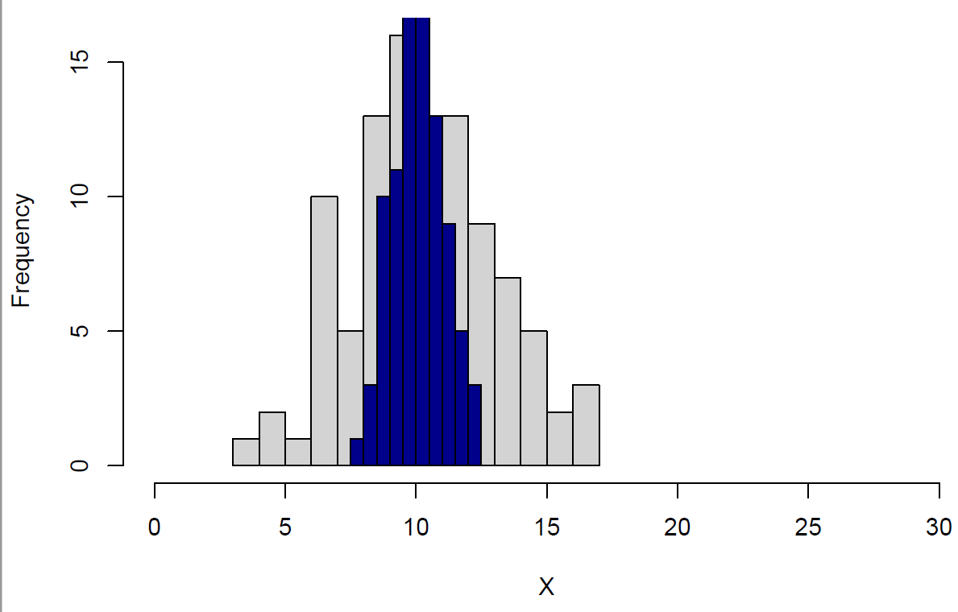
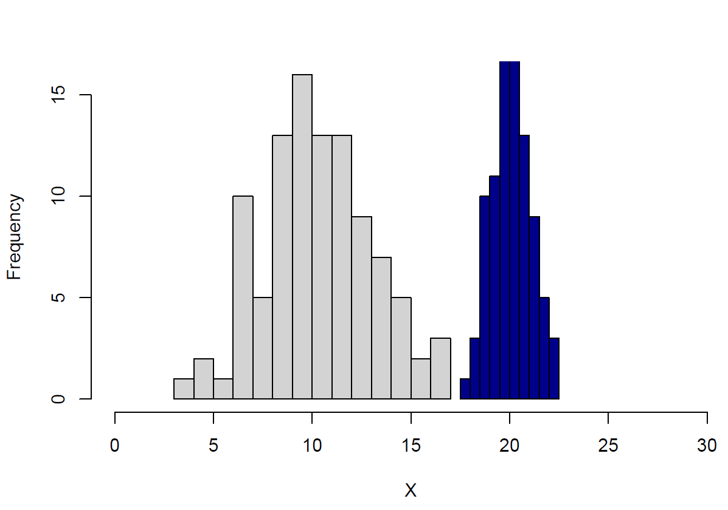
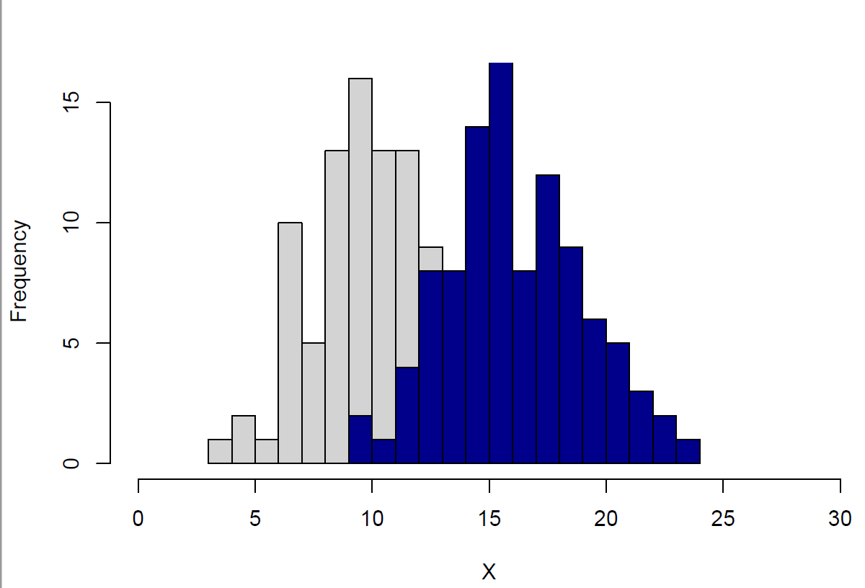
Power is largely determined by mean and variance

Slide 27
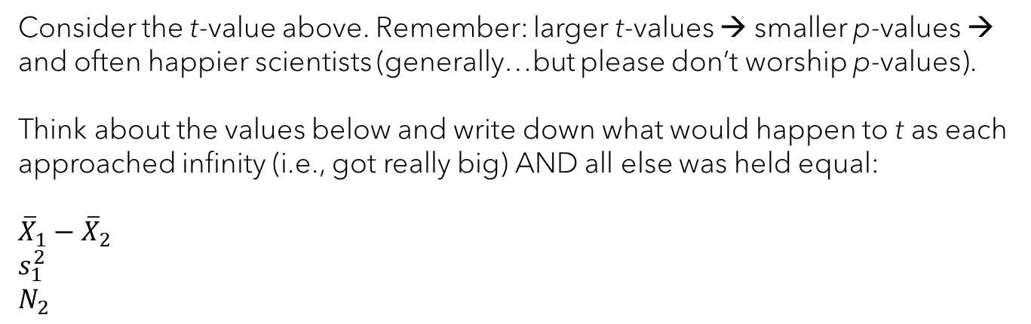

Activity: power of two sample t-test
$$t=\frac{{\overline{X}}_{1}−{\overline{X}}_{2}}{\sqrt{\frac{s_{1}^{2}}{N_{1}}+\frac{s_{2}^{2}}{N_{2}}}}$$
Consider the t-value above. Remember: larger t-values → smaller p-values → and often happier scientists (generally…but please don’t worship p-values).
Think about the values below and write down what would happen to t as each approached infinity (i.e., got really big) AND all else was held equal:
$${\overline{X}}_{1}−{\overline{X}}_{2}$$
$$s_{1}^{2}$$
$$N_{2}$$

Slide 28
Power in regression
The more variance, the larger sample size that is needed to detect an effect (if present)…but be careful not to “p-hack”
Think about the effect size and use your expertise to determine if it is meaningful.
Y
Y
X
X

Slide 29
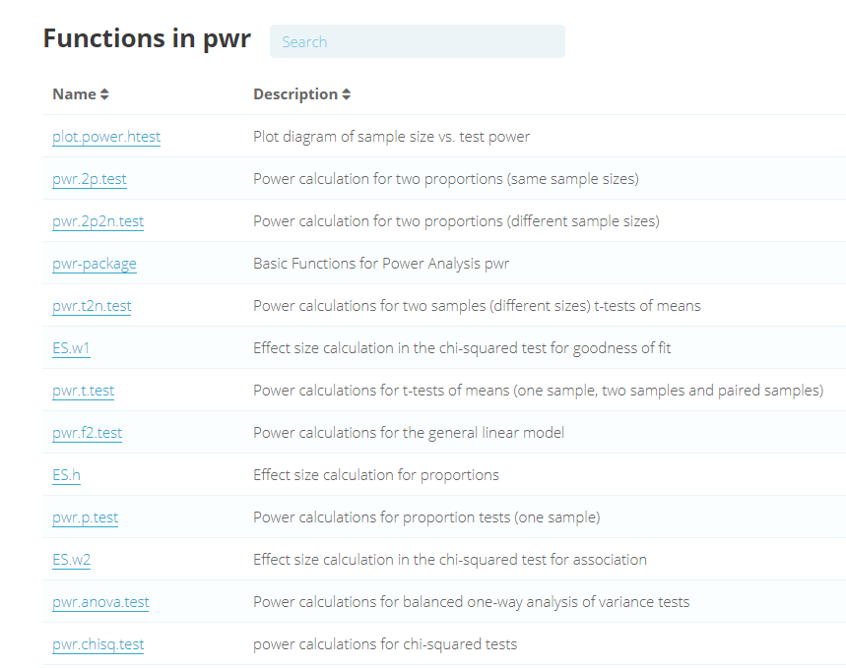
Power analysis in R

